Slide 1
ALICE School Safety Training for High School Students

Slide 2
ALICE School Safety Response
A school safety protocol created by a law enforcement officer as a response for students, faculty, and staff to utilize in the event of an armed intruder in a school building.
This training encourages staff and students to respond based on their situation, rather than rely on centralized instructions in dynamic times of crisis.

Slide 3
CURRENT POLICY IN ILLINOIS 105 ILCS 128
Mandated by Illinois State Board of Education
Conduct one law enforcement drill per year while students are present.

Slide 4
What is ALICE?
Any of these options might be your best FIRST option.

Slide 5
ALICE = ALERT
Use your senses to notice anything out of the ordinary.
Look
Listen
Smell
When you see something out of the ordinary,
ALERT an adult/teacher.

Slide 6
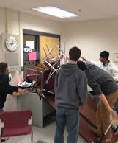
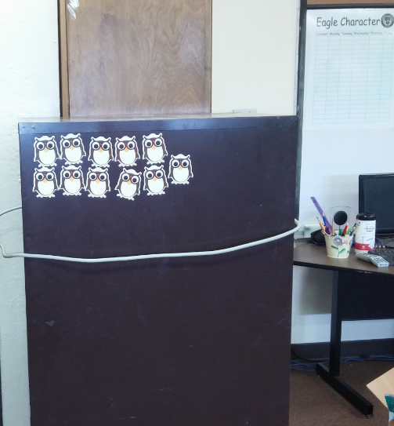
ALICE = LOCKDOWN
When there is an intruder in our school building, an adult/teacher will decide to either:
Have students find a safe route to evacuate the building
or
Remain in the classroom, go into Lockdown and barricade the door.

Slide 7
ALICE = Inform
If you see something that doesn’t seem right and causes concern, inform an adult/teacher right away.
01
If you are aware of an intruder in the building, make sure you are safe before informing an adult or calling 911.
02
When telling an adult or teacher, use clear language to communicate important details.
03
Notes:
We are all empowered to keep our school safe.

Slide 8
ALICE=Counter *Last Resort Option*
Distract
Talk to/at them
Make loud noises
Make wild gestures with arms and legs
Throw ANYTHING at them
DO NOT TOUCH THE WEAPON

Slide 9
ALICE = EVACUATE
When we decide to evacuate from a classroom, follow the adult/teacher’s directions to find a safe exit from the building.
If you are not in the classroom, use the safest and quickest route to exit the building.
Once outside, run to the Bank of Kampsville.

Slide 10
Where else can we use ALiCE?
Home
Church
Store
Walking outside
Restaurant
Anywhere!

